Slide 1
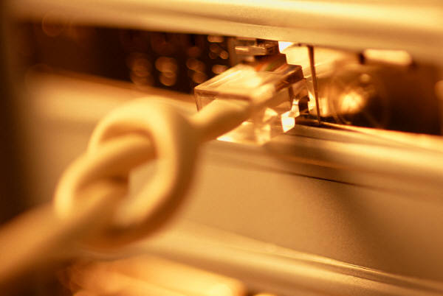
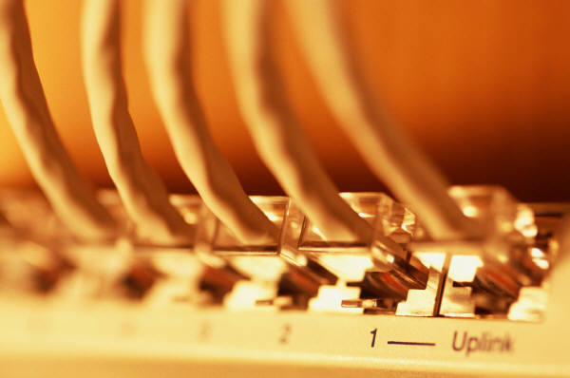
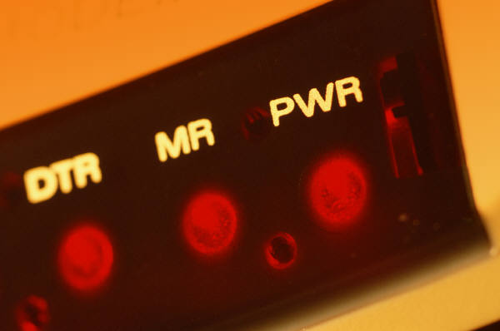
The Basics of Computer Networking
What do I need to know

Slide 2
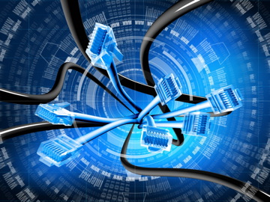
The Computer Network
Arguably, the greatest advancement in technology and communication over the past 20 years has been the development and advancement of the computer network. From emailing a friend to on-line bill paying to downloading data off the Internet to e-commerce, networking has made our world much smaller and changed the way we communicate forever.

Slide 3
The Computer Network
What is a Computer Network?
net·work: [net-wurk] – noun, a system containing any combination of computers, computer terminals, printers, audio or visual display devices, or telephones interconnected by telecommunication equipment or cables: used to transmit or receive information.

Slide 4
The Computer Network
What is a Computer Network?
The generic term node or host refers to any device on a network.
Data transfer rate – the speed with which data is moved from one place on a network to another
Data transfer rate is a key issue in computer networks

Slide 5
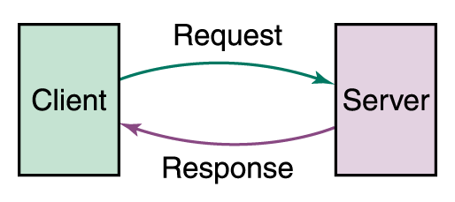
Networking
The Computer Network
What is a Computer Network?
Computer networks have opened up an entire frontier in the world of computing called the client/server model
15-<number>

Slide 6
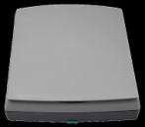




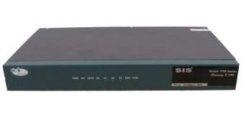
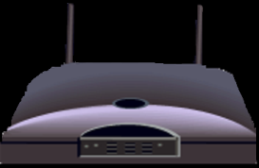
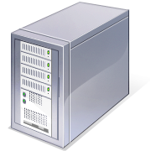

The Network Diagram
(Click on the Words Below and Learn More About Each Component)
Wired Network
PC
Firewall
The Internet
Fiber Optic Network Cable
Router
Switch
Server
Other LANS
Wireless Network

Slide 7
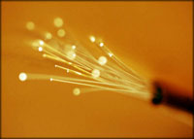
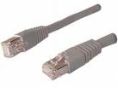
Fiber Optic Cable
Standard Network Copper Cable
Reduces interference in the network
Transmit data faster than copper network cable
Allows for more bandwidth
Smaller and more fragile than copper cable

Slide 8
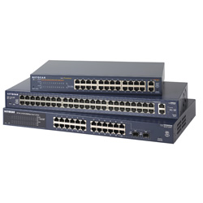
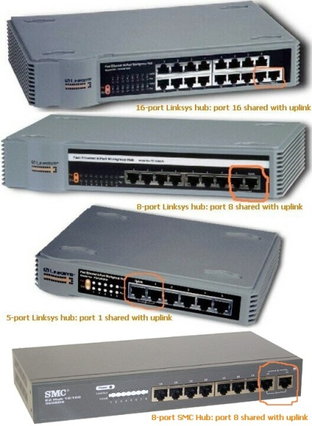
Switches and Hubs
Network Switches
Network Hubs
Data travels faster through switches because data is not sequenced as it is in a hub
The information is more secure when it passes through a switch as opposed to a hub.
Information travels more efficiently through a switch because travels directly to it’s destination as opposed to being broadcast to all PC’s on the network hub.

Slide 9
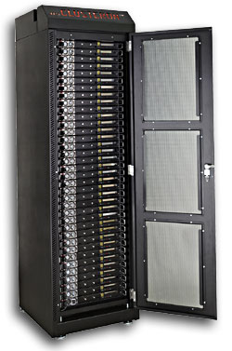
Servers
Users are connected to certain servers which will fulfill the required request.
There are 3 Principle Types of Servers
Print Servers
Contains the name and location of all printers that are on the Network
File Servers
Contain the location and names of the various drives, files, and folders on a Network
Web Servers
Contain the Programs, Files, and Internet Web Sites. Dedicated to responding tio requests (from the browser client) for web pages.
Rack of Servers

Slide 10
Web Servers
IP Addresses
“IP” stands for Internet Protocol. IP Addresses serve as the location of websites on the Internet as well as the workstations that are connected to the web. IP addresses are made up of four sets of numbers called “Octets”. There are two types of IP Addresses: Static and Temporary. Below is a description of both.
Static IP Addresses
Temporary IP Addresses
Static IP addresses are found only on servers and remain the same.
A Domain Name Server assigns a “human readable” web address to each static IP address to make it more user friendly.
Temporary IP addresses are found only on PC’s are constantly changing each time it is logged on.
Temporary IP addresses are assigned by an ISP (Internet Service Provider) each time it is logged on to the Internet.

Slide 11
Firewalls
A firewall is a software that can be loaded on to a network that can serve as a barrier that keeps destructive forces away from a network of computers.
Packets of data are analyzed against a set of criteria or standards called filters.
Filters block certain designated IP addresses.

Slide 12
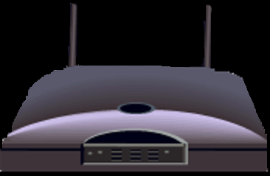
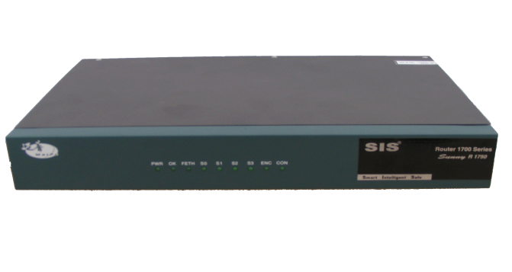
Routers
Standard Router
Wireless Router
Whether a Router is traditional or wireless, its purposes remain the same.
Routers are specialized computers that send your messages and those of every other Internet user speeding to their destinations along thousands of pathways.
Routers are crucial devices that let messages flow between networks, rather than within networks.

Slide 13
Wireless Networks
Allows for computers to be moved easily without having to worry about wires or cables
Walkie-Talkie Network
You would equip each computer with basically, a walkie-talkie.
You would give each computer a way to set whether it wants to transmit or receive.
A wireless network converts binary signal (0’s and 1’s) into a radio signal (series of beeps).

Slide 14

The Internet
Internet – International Network
The simplest definition of the Internet is that it's a network of computer networks

Slide 15
The Internet
How Information Travel Through the Internet
A page on the Internet—whether it's full of words, images or both—doesn't come to you in one shipment. It's translated into digital information, chopped into 1500 byte pieces called PACKETS, and sent to you like a puzzle that needs to be reassembled. Each part of the packet has a specific function:
Sequence ID
ID’s where the information belongs in relation to the rest of the information
Header
Provides the complete destination address for the packet
End of Message
ID’s the end of the packet
Data Block
The portion of the overall information carried by the packet

Slide 16
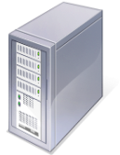

The Internet
How Information Travel Through the Internet
When you connect to a Web site through an ISP and start exchanging information, there isn't a fixed connection between your computer and the Web server computer hosting the Web site. Instead, information is exchanged using the best possible path at that particular time. Special computers called routers determine these paths, avoiding slow links and favoring fast ones.
Your Computer
ISP
Web Servers
Routers

Slide 17
Network Physical Topologies
Network Topology refers to the shape of a network, or the network's layout. How different nodes in a network are connected to each other and how they communicate are determined by the network's topology.
Should not be confused with logical topology which is the method used to pass information between workstations.
Topology shape does not necessarily correspond to actual physical layout of devices on network e.g. the computers in a family room maybe arranged in a circle but the actual topology could be a star be confused with logical topology which is the method used to pass information between workstations
Notes:
The topology section of my presentation may have been a little confusing for those who are not in the IT or networking field. I tried to explain the process and function of topologies using the subsequent slides and the features of each topology.

Slide 18
When choosing a Topology
Money – How much money is available to create this network
Length of cable – room size and number of equipment
Future growth – the possibility that there will be addition to the network
Cable type – type of cable determine data transmission

Slide 19
Choosing Topology
Network Topology afects its capabilities. The choice of one over another will have an impact on the:
Types of equipment the network needs
Capabilities of the equipment
Growth of the network
Ways the network is managed
Developing a sense of how to use the different topologies is a key to understanding the capabilities of the different types of networks. topology which is the method used to pass information between workstations

Slide 20
Choosing Topology
Network Topology affects its capabilities. The choice of one over another will have an impact on the:
Types of equipment the network needs
Capabilities of the equipment
Growth of the network
Ways the network is managed
Developing a sense of how to use the different topologies is a key to understanding the capabilities of the different types of networks. topology which is the method used to pass information between workstations

Slide 21
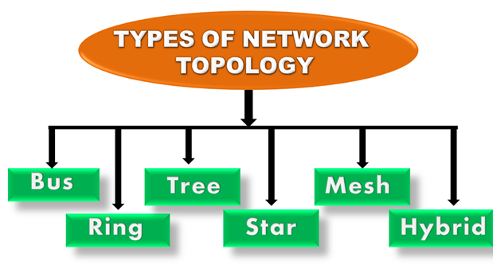

Slide 22
Bus Topology
T
T
Simplest of all the topologies
All devices are connected to a central cable, called the bus or backbone.
There are terminators at each end of the bus that stops the signal and keeps it from traveling backwards.
Communication is always done through the bus

Slide 23
Bus Topology
Advantages
Disadvantages
East to setup and expand
Cost effective
Cable elngth required least in comparison to other topologies
Mostly used in small networks. Good for LAN
Limit to cable length and number of nodes
If main cable collapses so does network
Difficult to detect and troubleshoot each node
Not as fast a ring topology
Maintenance cost high
Not suitable for heavy traffic
Security very low as all computers receive signal

Slide 24
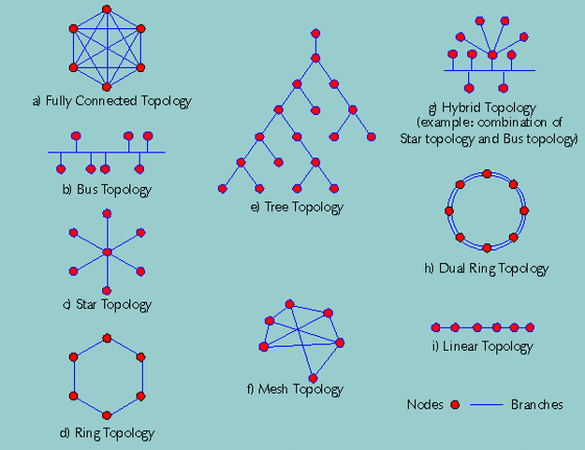
Ring Topology
All devices are connected to one another in the shape of a closed loop with no terminators.
Each device is connected directly to two other devices, one on either side of it.
Sending and receiving data takes place with the help of a TOKEN

Slide 25
Ring Topology
Advantages
Disadvantages
Good performance
Very organized for communication
No need for a server
Expansion does not affect performance
Each computer has equal access to resources
Cheap installation and expansion
Slower than Star because data must pass through all computers between source and destination
Crashed computer then entire network is disrupted
Difficult to add or delete nodes as it interrupts network activity
Highly dependent on the cable choice

Slide 26
Star Topology
All devices are connected to a central hub.
Nodes communicate across the network by passing data through the hub or switch.

Slide 27
Star Topology
Advantages
Disadvantages
Fast performance due to low network traffic
Devices isolated
Installation easy
Trouble shooting easy
Easy to replaced down nnode with affecting network
Expensive
Depends on central device for network to operate

Slide 28
Mesh Topology
All devices are interconnected with one another
Commonly used for wireless networks
Has n(n-1)/2 channels to connect n nodes
Two types – full and Partial
Full – every node is directly connected to all other nodes on the network
Partial – not all nodes are connected to all other nodes. It is a more practical form

Slide 29
Mesh Topology
Advantages
Disadvantages
Every connect has the ability to carry its particular data load
Very robust
Troubleshooting easy
Provides privacy and security
Challenging to install and configure
Cabling is costly as all nodes are connected
Bulk wiring essential

Slide 30
Tree Topology
All devices are connected in a hierarchical manner with all nodes being connected to the topmost (root) node
has at least 3 levels of hierarchy
It is an expansion of the bus and star topologies

Slide 31
Tree Topology
Advantages
Disadvantages
Easy to expand
Easy to maintain and manage
Easy to troubleshoot
Expensive when compared to other topologies
Profound cables
If root node collapses network collapses

Slide 32
Hybrid Topology
topology comprising two or more different types of topologies

Slide 33
Hybrid Topology
Advantages
Disadvantages
Trouble shooting ea
Flexible making it effective
Scalable since size can be made greater easily
Expensive as involves more than one topologies
Complicated to design

